Slide 1

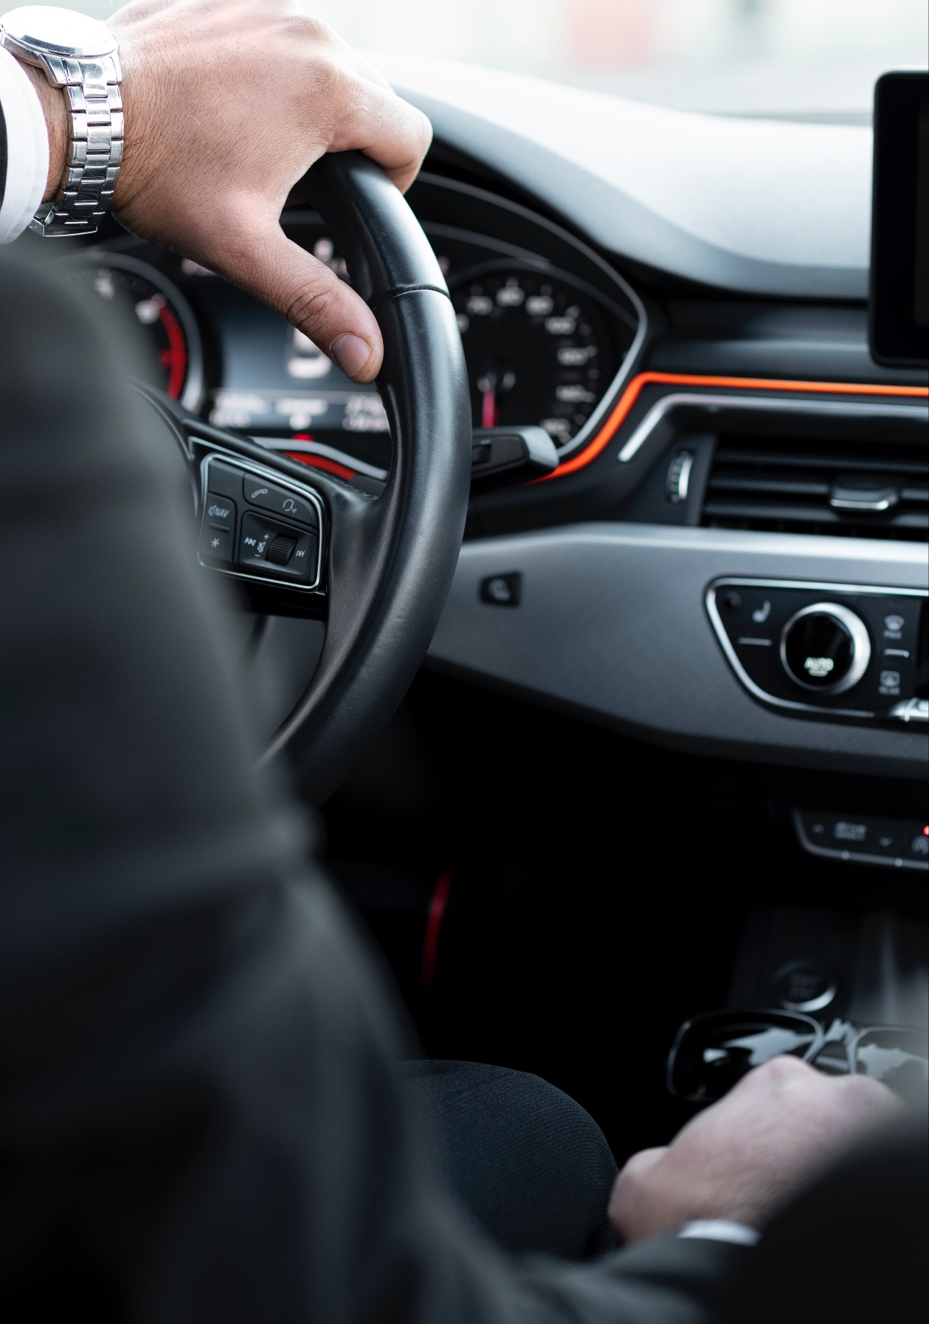
Comprehensive Autonomous Driving System
Lane detection system
Presented by: Batch No - 2
Lead: Dyna Joshy
Co-lead: SriJishnu Pagadala
Team members: Rakshitha N
Under the Guidance of
Mr. Nitig Singh

Slide 2
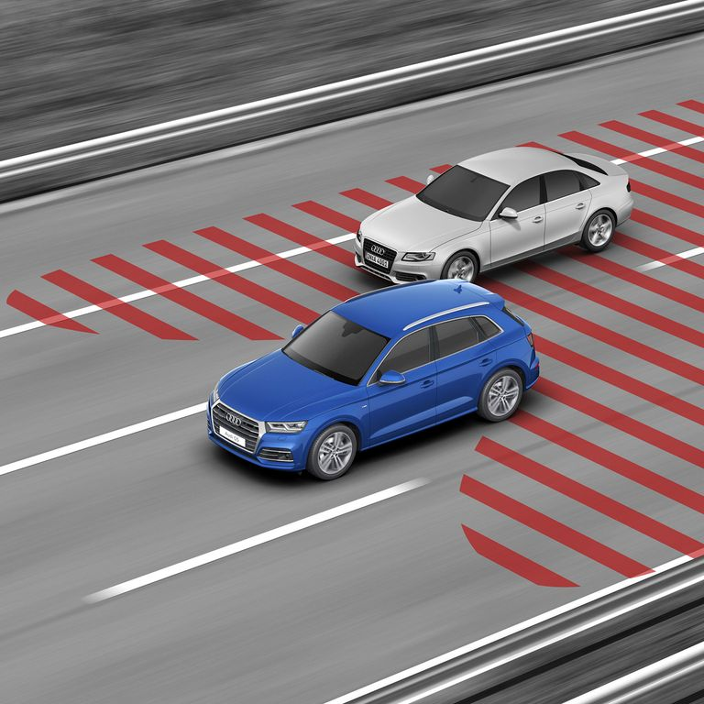
Lane detection system
The lane detection system is a key feature in autonomous driving, responsible for identifying and tracking lane markers on roads to ensure the vehicle stays within the correct path.
This processes visual data in real time, allowing the vehicle to adjust steering and positioning.

Slide 3
Why this module??
Safety
Navigation
Autonomous Driving
Traffic Regulations

Slide 4
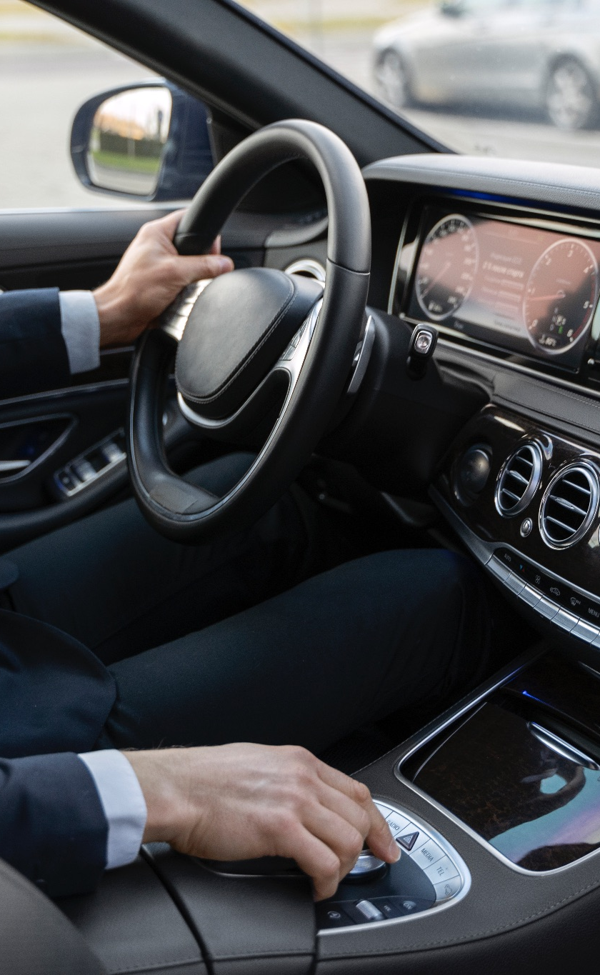
Objectives
Accurately identify and track lane boundaries to ensure the vehicle remains within its designated lane.
Process visual data in real time to enable timely adjustments and maintain proper lane positioning.
Adapt to various road conditions, including different lane types, weather scenarios, and lighting variations, to ensure consistent performance.
Minimize lane departure by providing precise steering inputs to keep the vehicle centered in its lane.
Enhance overall safety and navigation by integrating lane detection with other driving assistance systems to prevent collisions and ensure smooth driving.

Slide 5
Model approaches used:
Object detection based : DeepLab3
Segmentation-based: ERFnet

Slide 6
Initial setups
Yolov10 with VGG
DeepLabv3
ERFNet

Slide 7
DeepLabV3 in Lane detection
Semantic Segmentation: Used for precise lane marking detection by classifying each pixel in an image.
Contextual Information: Captures contextual features effectively, which helps in identifying lanes in complex urban environments.
Multi-Scale Features: Handles variations in lane sizes and distances by leveraging multi-scale input processing.

Slide 8
ERFNet in Lane Detection
Real-Time Processing: Designed for efficient inference, making it suitable for real-time lane detection applications.
Lightweight Architecture: Provides good performance with lower computational requirements, ideal for embedded systems and mobile applications.
Robustness to Occlusion: Better at handling occluded lane markings due to its encoder-decoder structure that retains spatial information.

Slide 9
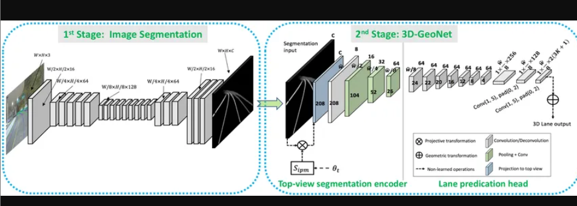
Architecture of ERFNet

Slide 10
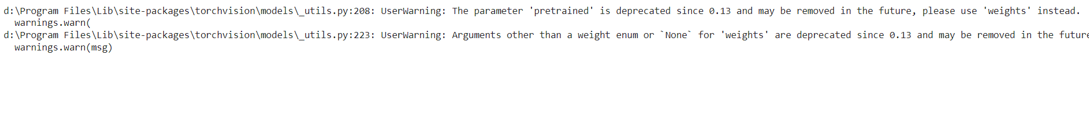
Challenges with yolo
High Resource Demand
Complexity of Scenes
Real-Time Constraints

Slide 11
Challenges with deeplabv3
High Computational Cost: Requires significant GPU resources for training and inference.
Complexity of Urban Scenes: Diverse and cluttered environments can confuse the model.
Class Imbalance: Lanes may be underrepresented compared to other objects in the dataset.
Data Annotation Quality: Inaccurate or inconsistent lane markings can affect model performance.
Generalization: Difficulty in adapting to different weather conditions and lighting variations.
Real-Time Processing: Struggles with maintaining frame rates suitable for real-time applications.

Slide 12
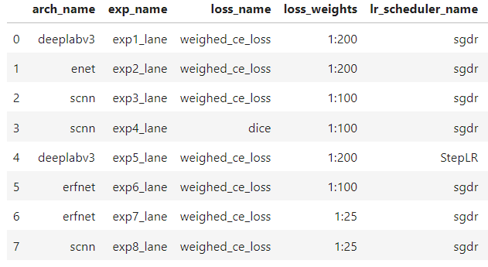
Different model comparisons

Slide 13
Introduction
Purpose: Lane detection systems are crucial for autonomous vehicles, enabling them to identify and follow lane markings on roads for safe navigation.
Technology: These systems utilize computer vision and machine learning algorithms to process camera images and recognize lane boundaries in real time.
Sensors: Most lane detection systems rely on cameras, LiDAR, and radar sensors to gather data about the vehicle's environment and road conditions.
Safety: By accurately detecting lanes, these systems enhance vehicle safety by reducing the risk of drifting out of lanes and potential collisions.
Integration: Lane detection works in conjunction with other autonomous driving features, such as adaptive cruise control and collision avoidance systems, to create a cohesive driving experience.
Challenges: Factors like weather conditions, road markings quality, and dynamic environments (e.g., construction . zones) present challenges that ongoing research aims to address for improved reliability

Slide 14
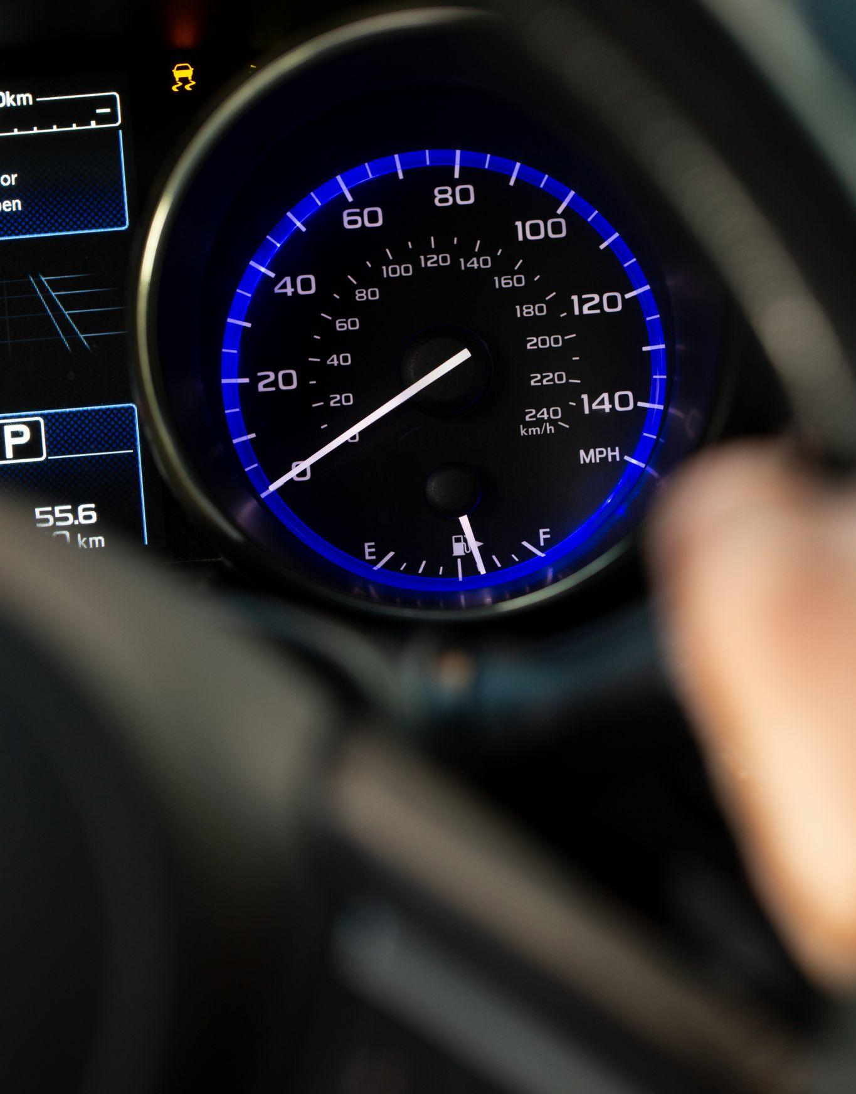
Steps completed:
1. Setup and Installation
We installed necessary libraries like torch, torchvision, matplotlib to support deep learning and visualization tasks
2. Dataset Preparation
Employed the Cityscapes dataset for training and validation.
Implemented a custom PyTorch Dataset class to load and preprocess images and lane masks.
Applied transformations, including resizing, normalization, and tensor conversion for effective model input.
3. Model set up(DeepLabV3)
Loaded the pre-trained DeepLabV3 model with a ResNet-101 backbone.
Modified the model to accommodate 20 classes (19 for Cityscapes and 1 background class).

Slide 15
Steps completed(contd):
4. Training Setup
Defined the loss function (CrossEntropyLoss) and optimizer (Adam with a learning rate of 0.0001).
Prepared PyTorch data loaders for training and validation with batch sizes of 4.
5. Training Process
Created a training function to perform forward and backward passes, optimize the model, and compute the loss.
Conducted training over epochs to fine-tune the model for lane detection.

